Slide 1
CELLULAR AND MOLECULAR BIOLOGY ( SEBB4173) Chapter 4 : DNA TRANSLATION
Dr. Noor Hidayah

Slide 2
4.1 Introduction to Proteins
Proteins are biological polymers that carry out most of the cell's day-to-day functions.
Some functions of proteins:
structural,
take part in cell movement,
help take up nutrients,
generate energy,
carry out biochemical reactions (e.g. the synthesis of nucleotides and their assembly into nucleic acids).

Slide 3
If protein is like a string of beads…
Peptide bonds
Amino acids

Slide 4
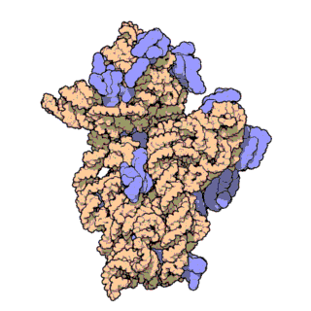
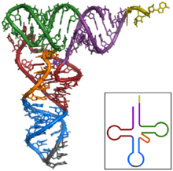
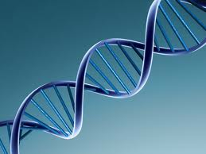
Molecules whose primary role is to carry information (e.g. DNA and mRNA) - linear molecules with a regular repeating structure.
Molecules that form cellular structures or have active roles carrying out reactions - normally folded into 3D structures (e.g. proteins, rRNA and tRNA).

Slide 5
So how do you define proteins?
Proteins
are made from a linear chain of monomers,
are folded into a variety of complex 3D shapes.
a chain of amino acids is called a polypeptide.
some proteins consist of more than one polypeptide chains.

Slide 6
4.1.1 Role of Proteins in the Cell
Four main categories:
Structural protein
Enzyme
Regulatory protein
Transport protein

Slide 7
4.1.1.1 Structural proteins
Are found making up many subcellular structures.
Examples:
the flagella with which bacteria swim around,
the microtubules used to control traffic inside cells of higher organisms,
the fibers inside a muscle cell,
the outer coats of viruses.

Slide 8
4.1.1.2 Enzymes
Proteins that carry out chemical reactions.
First binds another molecule (substrate), then performs some chemical operations with it.
Some bind only a single substrate molecule; others may bind two or more. Then react them together to make the final product.
Needs an active site (a pocket or cleft in the protein), where the substrate binds and the reaction occurs.

Slide 9
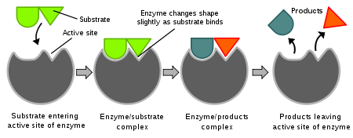
http://en.wikipedia.org/wiki/Enzyme

Slide 10
The active site - produced by folding up the polypeptide chain correctly so that amino acid residues that were spread out now come together and will co-operate in the enzyme reaction.

Slide 11
Active site amino acid
Polypeptide chain
folding
substrate
Pocket formed by active site residue

Slide 12
4.2 Regulatory and Transport Proteins
These proteins are not enzymes.
But they bind other molecules and so need "active sites" to accommodate the molecules.
4.2.1 Regulatory proteins
Vary enormously.
Many can bind both small signal molecules and DNA.
The presence or absence of the signal molecule determines whether or not the gene is switched on.

Slide 13
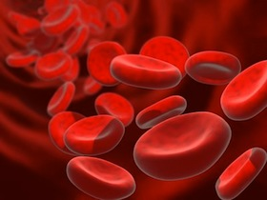
4.2.2 Transport proteins
Found mostly in biological membranes, where they carry material from one side to the other.
Nutrients, must be transported into cells of all organisms, while waste products are deported.
Multicellular organisms have transport proteins to carry materials around the body, e.g. hemoglobin.

Slide 14
To function properly many proteins need extra components (cofactors or prosthetic groups) which are not themselves proteins.
Many proteins use single metal atoms as cofactors, others need more complex molecules.
Prosthetic groups - fixed to the protein,
Cofactors - free to wander around from protein to protein.
These terms are often used loosely.
A protein without its prosthetic group is called an apoprotein.

Slide 15
Let’s consider hemoglobin as an example.
Oxygen carrier proteins such as hemoglobin have a ring-shaped cofactor with a central iron atom (heme).
The heme is bound in the active site of the apoprotein (globin), giving hemoglobin.

Slide 16
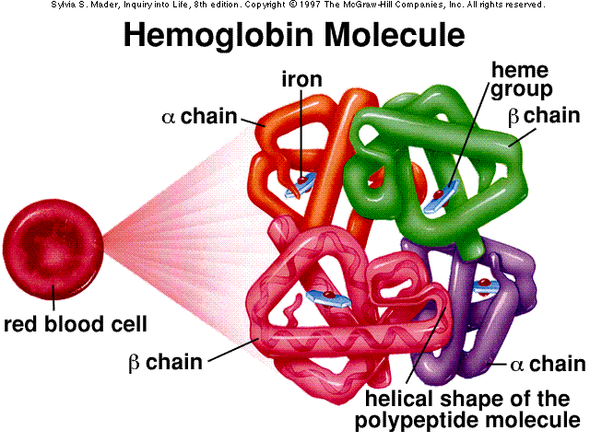
http://gassama.myweb.uga.edu/

Slide 17
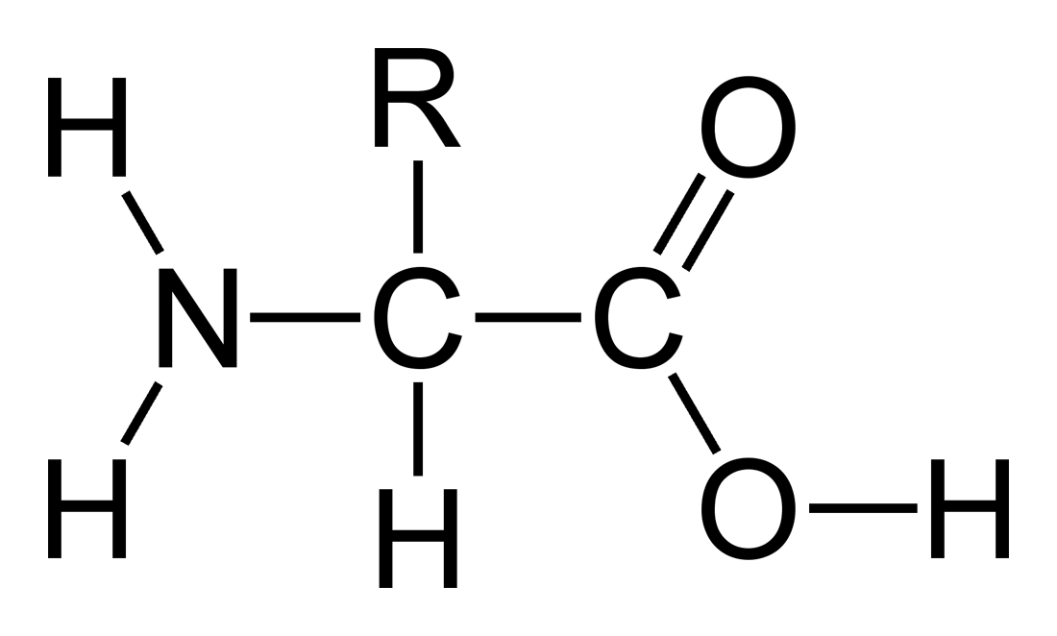
4.3 How Are Proteins Constructed?
There are 20 different amino acids used in making proteins.
All have central carbon atom (α carbon) surrounded by the four features below…
4
α
1
2
3

Slide 18
Formation of Polypeptide Chains
Amino acids are joined together by peptide bonds to give a linear polymer called a polypeptide chain.
The first amino acid in the chain retains its free amino (NH₂) group - called the amino or N-terminus.
The last amino acid to be added is left with a free carboxyl (COOH) group - called the carboxyl or C-terminus.

Slide 19
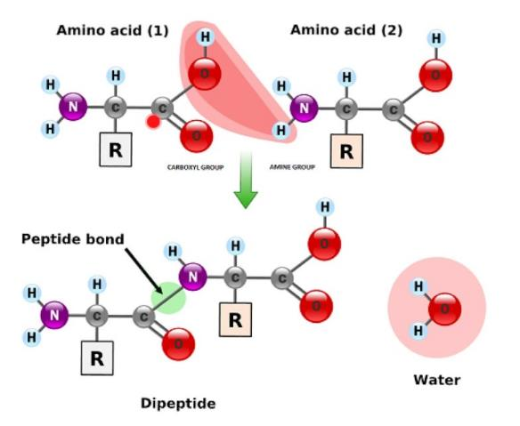
Peptide Bond
covalent bond formed between the α-amino group of one amino acid and the α-carboxyl group of another.
a simple elimination of water molecule between carboxyl and amino group.
Notes:
The peptide bond is a chemical, covalent bond formed between the α-amino group of one amino acid and the α-carboxyl group of another. Once two amino acids are joined together via a peptide bond to form a dipeptide, there is still a free amino group at one end and a free carboxyl group at the other, each of which can in turn be linked to further amino acids

Slide 20
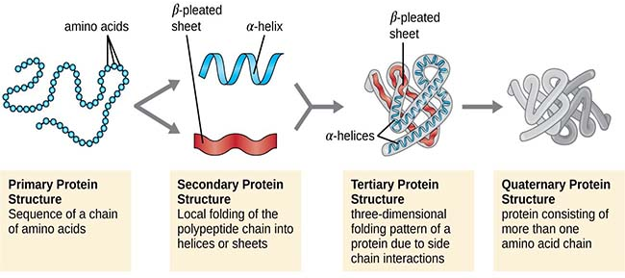
4.4 Protein Structure

Slide 21
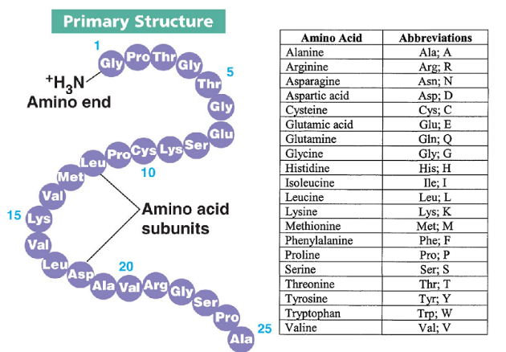
Primary Structure
The sequence of amino acids in a polypeptide or protein molecule.
Notes:
The length of polypeptides is commonly 100-1000 amino acids, but smaller and larger ones also can be found.
Chains containing only few amino acids residues: Oligopeptide Chains with many residues: Polypeptide

Slide 22
Secondary Structure
After synthesis, polypeptide chains are folded or pleated into different shapes:
Alpha helix (regular 3D shape)
Beta-pleated sheet (twisted, pleated sheet)
The helix is hold by many Hydrogen bonds between amino acids at different places in the chain, giving the shape great stability.

Slide 23
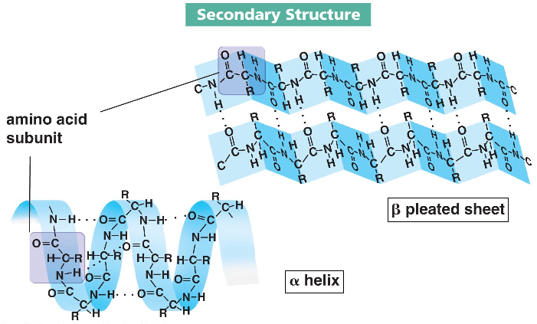
The way in which the primary structure of a polypeptide chain folds.

Slide 24
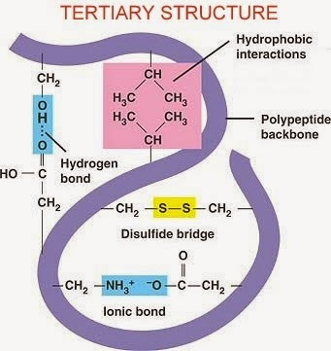
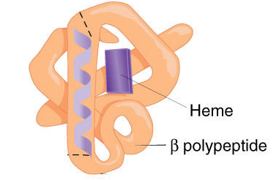
Tertiary Structure

Slide 25
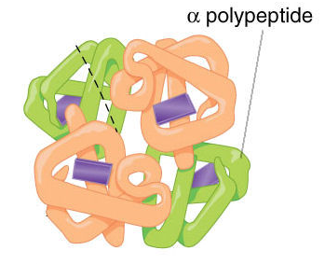
Quaternary structure
Quaternary structure: ≥ 2 polypeptide chains join together to form a protein
some proteins are made up of multiple polypeptide chains
inorganic component (e.g. a haem group in haemoglogin) called a Prosthetic Group.
The polypeptide chains are held by the same type of bonds as in the tertiary structure.
.
Notes:
The tertiary and quaternary structures of a protein, and its properties, are determined by its primary structure

Slide 26
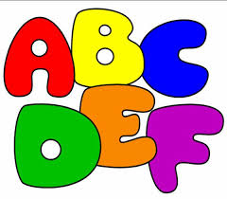
4.5 20 Different Amino Acids
There are 20 different AAs in proteins.
This allows for a great variety of 3D structure and of chemical reactivity.
They may be represented by both three-letter and one-letter abbreviations.
One-letter system is used when writing out protein sequences.

Slide 27
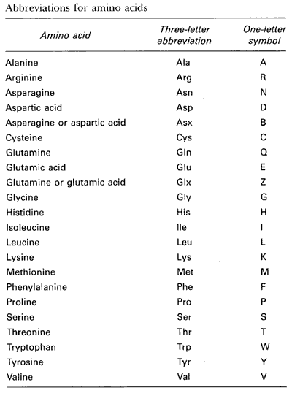
http://carolguze.com/text/102-3-biomolecules2.shtml

Slide 28
4.6 How are Proteins Made?
Each protein is made using the genetic information stored on the chromosomes. The genetic information is transmitted in two stages.
First, the information in the DNA is transcribed into mRNA.
Second, the information carried by the mRNA is used to give the sequence of amino acids making up a polypeptide chain.

Slide 29
This involves converting the nucleic acid "language” to protein "language” ➔ TRANSLATION.
An early rule of molecular biology stated that there is only one gene for each protein. This is generally true.
But exceptions have also been found.

Slide 30
The Central Dogma
Replication
DNA
The overall flow of information in biological cells is known as CENTRAL DOGMA of molecular biology (first formulated by Francis Crick).
DOGMA = “a fixed, especially religious, belief or set of beliefs that people are expected to accept without any doubts.”
TRANSCRIPTION
RNA
TRANSLATION
Protein

Slide 31
4.7 Decoding the Genetic Code
During translation, the bases of mRNA are read off in groups of three.
These are known as codon, representing a particular AA.
There are four different bases (A, C, T/U, G), so there are 64 possible groups of three bases, i.e. 64 different codons.
(4³) = 64.
There are only 20 different AAs making up proteins.
This means some AAs are encoded by more than one codons.

Slide 32
AGA
AGG
CGA
CGG
CGT
CGC
GCA
GCG
GCT
GCC
GGA
GGG
GGT
GGC
ATA
AT T
ATC
DNA Codon
GAT
GAC
AAT
AAC
TGT
TGC
GAA
GAG
CAA
CAG
CAT
CAC
Amino Acid
Ala
Arg
Asp
Asn
Cys
Glu
Gln
Gly
His
Ile
T TA
T TG
CTA
CTG
CTC
CT T
AGT
AGC
TCA
TCG
TCT
TCT
GTA
GTG
GT T
GTC
Start
CCA
CCG
CCT
CCC
ACA
ACG
ACC
ACG
TAA
TAG
TGA
AAA
AAG
TAC
TAT
T T T
TTG
TGG
ATG
Leu
Lys
Met
Phe
Pro
Ser
Thr
Trp
Tyr
Val
STOP

Slide 33
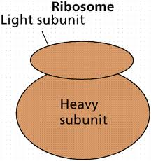
4.8 Ribosome - The Cell's Decoding Machine
The decoding process is carried out by ribosome.
Ribosome binds mRNA and translates it, synthesising a polypeptide chain.
In this chapter we'll discuss about protein synthesis in bacteria. (The details of protein synthesis differ between bacteria and higher organisms).
Bacterial ribosome consists of two subunits, large (50S) and small (30S).
Notes:
Ribosomes are made from complexes of RNAs and proteins.

Slide 34
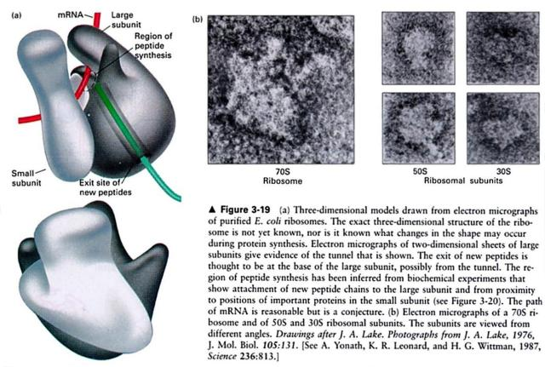
Structure of the Ribosome. The ribosome, especially when it has an mRNA and a growing polypeptide chain attached is easily visible with the electron microscope.

Slide 35
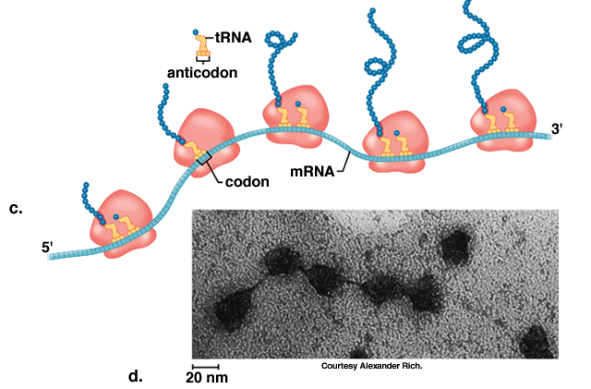
After binding to the mRNA, the ribosome moves along it, adding a few AAs to the growing polypeptide chain each time it reads a codon from the message.
http://www.southtexascollege.edu/nilsson/4_gb_lecturenotes_f/4_gb_11_dna_spr2003.html

Slide 36
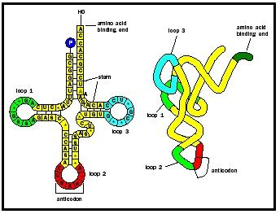
4.9 transfer RNA (tRNA)
To read the codon, we need a set of adapter molecules that recognise the codon on the mRNA at one end, and carry the corresponding AA attached to their other end.
These adapters are transfer RNA or tRNA.
http://www.biologyreference.com/Ta-Va/Transfer-RNA.html#b

Slide 37
At one end, the tRNA has an anticodon consisting of three bases complementary to the three bases of the codon on the mRNA.
The codon and anticodon recognise each other by base pairing and are held together by hydrogen bonds.
At its other end, each tRNA carries the AA corresponding to the codon it recognises.
Remember the codon table?

Slide 38
Each tRNA carries only a single AA so we need at least 20 different tRNAs because there are 20 different AAs.
There are 64 codons to be recognised as some AAs have more than one codon.
In practice, the number of different tRNA molecules is somewhere between 20 and 64.
Some tRNAs can read more than one codon, but these must all code for the same amino acid.

Slide 39
4.10 How Does the tRNA get its Amino Acid?
For each tRNA, there is a specific enzyme that recognises both the tRNA and the corresponding AA.
The enzymes, known as aminoacyl tRNA synthetases attach the AA to the tRNA.
This is called charging the tRNA.
Empty tRNA is known as uncharged tRNA, while tRNA with its AA is charged tRNA.

Slide 40
Acceptor stem
Uncharged tRNA
tRNA
Amino acid
Anti codon
Amino acyl tRNA synthetase
Charged tRNA

Slide 41
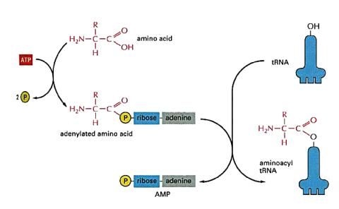
Charging the tRNA: The Chemical Scheme

Slide 42
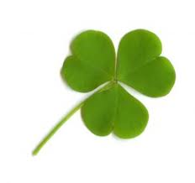
4.11 Structure of tRNA
A typical RNA has four short base-paired stems and three loops.
Cloverleaf structure- to show details of base-pairing, and shows the tRNA spreads out. The amino acid is bound at the free end of the acceptor stem.
The anticodon is at the opposite end in the anticodon loop. The other two Ioops of tRNA are named after modified bases. The TψC loop contains “ψ” which stands for pseudouracil and the D-loop has “D” for dihydrouracil.

Slide 43
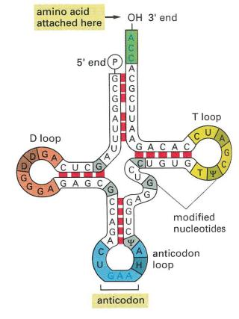
Amino acid attaches here
anticodon

Slide 44
ψ and D are required for proper folding and operation of the tRNA.
The TψC Ioop and the D-loop are needed for binding to the ribosome and for recognising the enzyme aminoacyl tRNA synthetase.
In real life the tRNA cloverleaf is folded up further. The TψC loop and D-loops are pushed together and the molecule is bent into an L-shape.

Slide 45
4.12 Reading Frames
The bases of mRNA are read in groups of three, starting at the 5' end. We always begin with the start codon, AUG.
Consider the following message:
We have three possible start codons (underlined). Each of these starts at a slightly different point.
Each of the three leads us to take quite different groups of three bases.
1
2
3
^{5’}GAAAUGUAUGCAUGCCAAAGGAGGCAUCUAAGGA^{3’}

Slide 46
The three alternatives are illustrated in the next slide.
These three possibilities are known as “reading frames”.
As there are three bases in a codon, changing the reading frame by three or (a multiple of three) gets you back to where you started.

Slide 47
G A A A U G U A U G C A U G C C A A A G G A G G C A U C U A A G G A
1 1 1 2 2 2 3 3 3 4 4 4 5 5 5 6 6 6 7 7 7 8 8 8
1 1 1 2 2 2 3 3 3 4 4 4 5 5 5 6 6 6 7 7 7 8 8 8
1 1 1 2 2 2 3 3 3 4 4 4 5 5 5 6 6 6 7 7 7 8 8 8
C U A U G G C A A A U A A G G U A G A C C A U
Reading Frame A
Met
Ala
Asn
Lys
Val
Asp
His
C U A U G G C A A A U A A G G U A G A C C A U
Reading Frame B
Tyr
Gly
Lys
Stop
C U A U G G C A A A U A A G G U A G A C C A U
Reading Frame C
Leu
Trp
Gln
Ile
Arg
Stop

Slide 48
A stretch of RNA, beginning with a start codon, and which can therefore be translated into a protein, is known as an Open Reading Frame (ORF).
Any mRNA will have several possible ORFs and we have to find the correct one.

Slide 49
End of 1st part of Ch4

Slide 50
4.13 Getting Protein Synthesis Started
The first codon is always AUG, which codes for methionine.
A special tRNA (the initiator tRNA) will be charged with chemically-tagged Met (formyl-Met or fMet) and will bind to the start codon.
Sometimes the initial Met is snipped off later, so mature proteins do not always begin with Met.
There are also AUG codons in the middle of a message giving Met in the middle of the protein.

Slide 51
How does the ribosome know which AUG codon to start with?
Near the front (the 5' end) of the mRNA is the ribosome binding site (RBS, or Shine-Dalgarno sequence or S-D sequence).
The anti Shine-Dalgarno sequence (complementary to the S-D sequence) is found close to the 3' end of the 16S rRNA - causes the mRNA to bind to this rRNA.
In some cases the S-D is an exact match to the anti S-D sequence and these mRNAs are translated efficiently. In other cases the match is poorer and translation is less efficient.
The start codon is the next AUG codon after the RBS.
Notes:
16S ribosomal RNA (or 16S rRNA) is the RNA component of the 30S small subunit of a prokaryotic ribosome (SSU rRNA). It binds to the Shine-Dalgarno sequence and provides most of the SSU structure

Slide 52
Ribosome binding site (RBS)
RBS
fMet Val Ala Lys Ser
Protein
^{5’} GAUUCCUAGGAGGUUUGACCUAUGGUCGCUAAAAGU^{3’}
mRNA
UCCUCCA
^{3’}AU
CUAG^{5’}……………………………..
16S rRNA
Anti-Shine Dalgarno

Slide 53
4.13.1 Initiation of Translation
Before protein synthesis starts, the two subunits of the ribosome are floating around separately.
The 16S rRNA, with the complementary anti S-D sequence, is in the small subunit of the ribosome.
So FIRST the mRNA binds to a free small subunit.
NEXT the initiator tRNA (carrying fMet) recognises the AUG start codon.
You also need three proteins known as initiation factors, that help arrange all the components correctly.
FINALLY the large subunit arrives, and joins its smaller partner as the initiation factors drop off.

Slide 54
Small subunit
Formation of the Initiation Complex
UAC
UAC
AUG
fmet
fmet
fmet-tRNA
Large subunit
E
P
A

Slide 55
4.13.2 Elongation of a Growing Protein
After the large subunit of the ribosome has arrived, the polypeptide chain is made.
The ribosome has three sites for tRNA: the E-site (Exit site), A-site (Acceptor site) and P-site (Peptide site) starting with the fMet initiator tRNA in the P-site.
Another tRNA, carrying the exact amino acid, arrives and enters at the A-site. The fMet is cut loose from its tRNA and bonded to amino acid No. 2. So tRNA No. 2 now carries two linked amino acids, the beginning of our growing protein chain.
Large subunit
E
site
P
site
A
site

Slide 56
NEXT another charged tRNA arrives carrying the third amino acid. In order to fit the newcomer into the A-site we must push tRNA No. 2 sideways into the P-site.
THIS IN TURN pushes the free tRNA in the P-site off to the E-site.
As the peptide chain continues to grow, it is constantly cut off from the tRNA holding it (which occupies the P - peptide site) and joined instead to the newest amino acid to be brought by its tRNA into the A-site, hence the name "acceptor" site.

Slide 57
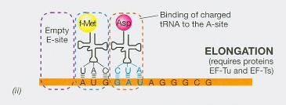
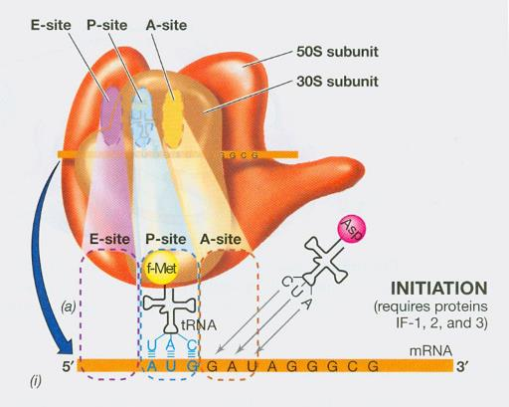
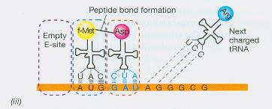
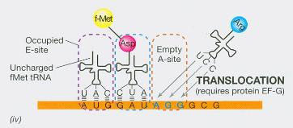
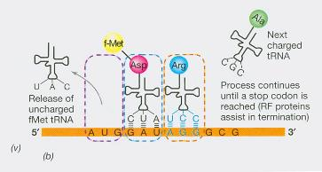

Slide 58
4.14 Termination of Protein Synthesis
This is marked by a stop codon (UGA, UAG, or UAA).
As no tRNA exists to read these three codons, the chain can no longer grow.
Proteins known as release factors read the stop signal and chop the completed polypeptide chain of the final tRNA.
The ribosome then falls apart into its separate subunits – the termination of polypeptide.

Slide 59
Termination of polypeptide synthesis
Release Factor
Last tRNA
STOP CODON
UUU
AAA
UAG

Slide 60
Termination of polypeptide synthesis

Release factor
Last tRNA
STOP CODON
UUU
AAA
UAG

Slide 61
4.15 One mRNA Can Code for Several Proteins
In bacteria, several proteins may be encoded by the same mRNA. As long as each ORF has its own S-D sequence in front of it, the ribosome will bind and start translating.
ORFs that are translated into proteins are sometimes known as cistrons.
mRNA which carries several of these is called polycistronic mRNA.
In higher organisms, this does not happen. Instead of a S-D sequence, the front (5' end) of the mRNA molecule is recognised, the first ORF is translated (Chapter 5).

Slide 62
Start codon
mRNA
Cistron
Cistron
Cistron
Stop codon
Protein
1
2
3

Slide 63
4.16 Several Ribosomes Can Read the Same Message at Once
Once the first ribosome has got moving, another can jump onto the same mRNA and travel along behind.
In practice, several ribosomes will move along the same mRNA about a hundred bases apart.
This structure is called a polysome (short for polyribosome).

Slide 64
5’
3’
Nearly completed protein

Slide 65
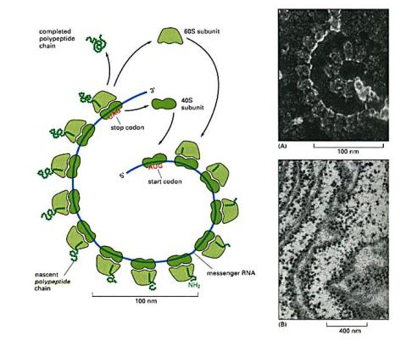
Polyribosomes. A polyribosome is formed when several ribosomes simultaneously translate a single mRNA

Slide 66
4.17 Coupled Translation and Transcription in Bacteria
When mRNA is transcribed from the original DNA template, its synthesis starts at the 5' end. The mRNA is also read by the ribosome starting at the 5' end.
This means the ribosome can start translating the message before the synthesis of the mRNA molecule has actually been finished.

Slide 67
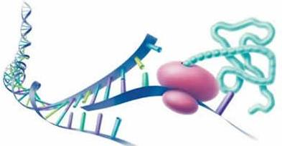
While transcription is on going…..
Translation has also begun here…….
The result is that you find partly finished mRNA, still attached to the bacterial chromosome via RNA polymerase, with a group of enthusiastic ribosomes already jumping aboard to get started.
This is known as coupled translation and transcription.

Slide 68
DNA initiation site
RNA polymerase
Translation
DNA transcription
Coupled Translation and Transcription

Slide 69
4.18 Some Proteins Come to a Bad End
If something can go wrong, it will (Murphy’s Law)
Ribosomes have their problems, too. One problem they sometimes come across is when they receive a defective mRNA.
Whether the mRNA was never properly finished or whether it was mistakenly snipped short by an over-enthusiastic RNA cutting enzyme, it can cause havoc.
A ribosome that is translating a message into protein expects to come across a stop codon.

Slide 70
Oh! Oh!!? Traffic jam!!!!
I see no STOPS!!
Wheeee!
Defective mRNA

Slide 71
Even if an mRNA molecule comes to an abrupt end, ribosomes may only be released by release factor.
This needs a stop codon.
If the mRNA is defective and there is no stop codon, a ribosome that reaches the end will just sit there forever and the ribosomes behind it will all be stalled too (ribosome pile up).
So what do we do to free these trapped ribosomes?
Bacterial cells contain a small but heroic RNA molecule that rescues stalled ribosomes.

Slide 72
tmRNA: because it acts partly like tRNA and partly like mRNA.
Like a tRNA, the tmRNA carries an amino acid (alanine). When it sees a stalled ribosome it binds beside the defective mRNA.
Protein synthesis now continues, first using the alanine carried by tmRNA, and then continuing on to translate the short stretch of message (of about 10 amino acids) that is also part of the tmRNA.
Finally, the tmRNA provides appropriate stop codon so that release factor can disassemble the ribosome and free it for its next assignment.

Slide 73
Short message for 10 amino acids
mRNA
tmRNA
Stop codon
tRNA
Alanine
polypeptide
Ribosome Rescued by tmRNA

Slide 74
tmRNA
No stop codon
tRNA
Alanine

Slide 75
But what about the protein we just made?
Clearly, it too is defective.
Shouldn't it be destroyed?
The short stretch amino acids specified by the message part of mRNA and added to the end of the defective protein acts as a signal.
This is recognized by tail-specific protease which munches unnecessary proteins.
tmRNA = "terminate me" RNA!

Slide 76

End of Chapter 4!

